Slide 1
Customer Purchase Behavior Analysis
Dheeraj Vempaty

Slide 2
Business Problem & Objective
To identify patterns and trends in customer purchases, predict future purchasing behavior, and tailor marketing efforts accordingly.
Improve marketing strategies
Segment customers
Predict purchases
Personalize campaigns

Slide 3
Data Sources, Design & ETL Pipeline
Tools :
Python – For data preparation, ETL scripts, and data quality automation
Google BigQuery – Data warehouse for storing staging, persistent, and reporting layers
Google Looker Studio – Dashboard and data exploration
Jupyter Notebooks – Development and documentation of ETL workflows
Visual Studio Code – IDE for code authoring and debugging
Steps:
Extract: From multiple sources
Transform: Clean, normalize, deduplicate
Load: Into a centralized data warehouse (BigQuery)
Source files -
Customers.csv
Stores.csv
Products.csv
Transactions.csv
ER Diagram

Slide 4
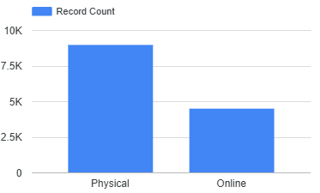
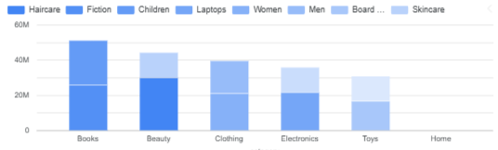
Data Insights - Sales by Channel
Physical stores generate higher(2x) sales compared to online, indicating a stronger in-store presence or preference.
Sales by Category/Sub-Category
Beauty, Books, and Toys dominate the total sales(~30% revenue) Consider focusing on these categories for targeted marketing campaigns.

Slide 5
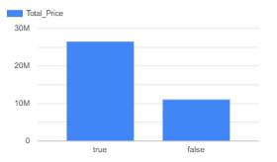
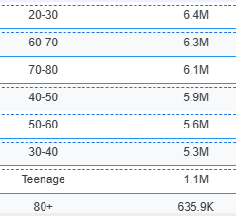
Data Insights - Loyalty Program
Loyalty customers contribute 70% of total revenue, underlining the importance of customer retention strategies.
Sales by Age Group
Younger customers (e.g., 19-30) tend to spend more, indicating that targeting this group with specific promotions could drive larger sales.

Slide 6
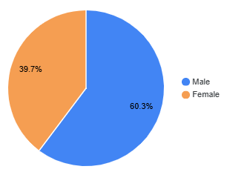
Data Insights - Sales by Gender
Males spend more overall, but targeting specific categories like beauty, clothing, and toys might appeal more to female customers.
Sales by Category/Sub-Category
Beauty, Books, and Toys dominate the sales. Consider focusing on these categories for targeted marketing campaigns.

Slide 7
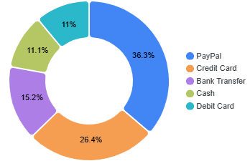
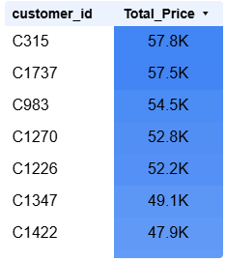
Data Insights - Payment Method
PayPal and Credit Card are the most popular payment methods(~60% of orders). Tailor promotions for these payment preferences.
Top 10 Customers by Total Spend
Focus on these high-value customers for personalized offers and loyalty rewards.

Slide 8
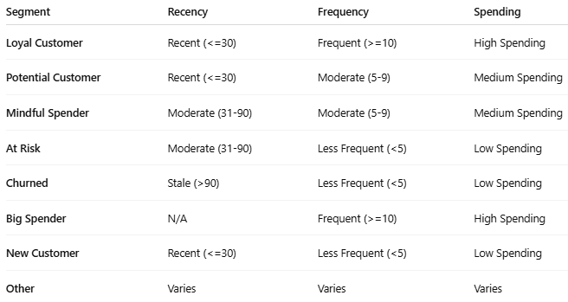
Derived Dimensions for Customer Categories

Slide 9
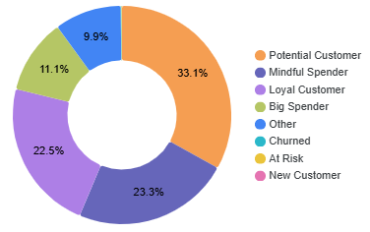
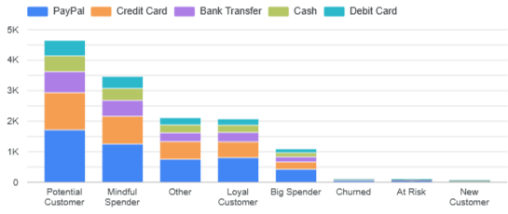
Data Insights – Customer Segments
Potential, Mindful and Loyal customer groups are contributing ~78% of total revenue.
Payment Preference by Customer type
PayPal and credit Cards are highly used by all types of customers. Offering incentives for preferred payment methods will gain more sales.

Slide 10
Conclusion & Recommendations
Focus on High-Value Segments: Target loyal, high-frequency, and high-spending customers with exclusive offers.
Increase Retention for Loyal Customers: Retain customers with personalized engagement.
Target Potential Customers: Use promotions and re-engagement campaigns to increase frequency and spending.
Win-Back Strategies for At-Risk and Churned Customers: Create win-back campaigns for customers that are at risk or churned.
Promote Key Categories: Leverage high-demand categories (Beauty, Books, and Toys) in marketing efforts.

Slide 11
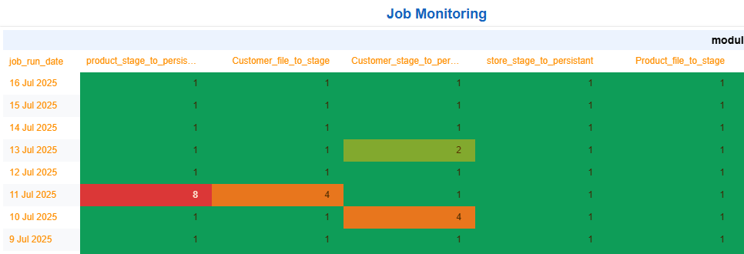
Data Monitoring, Security & Reconciliation
Monitoring: Log-based, pipeline validation
Security: Role-based access, encryption
Reconciliation: Source-to-target record validation & control totals

Slide 12
Derived Dimensions for Customer Categories
Recency: Categorized as 'Recent' (within 30 days), 'Moderate' (31-90 days), or 'Stale' (older than 90 days).
Frequency: Grouped into 'Frequent' (10+ purchases), 'Moderate' (5-9 purchases), and 'Less Frequent' (less than 5).
Spending: Categorized as 'High Spender' (spend > $10,000), 'Medium Spender' (spend between $5,000 and $10,000), and 'Low Spender' (spend < $5,000).
Customer Segment: Grouped as 'Loyal Customer', 'Potential Customer', ‘Mindful’, 'At Risk', 'Churned', 'Big Spender', and 'New Customer'.

